Slide 1

Supplementary Figure 2
Measuring up to reality: null models and analysis simulations to study parental coordination over provisioning offspring
Malika Ihle*, Joel L Pick, Isabel S Winney, Shinichi Nakagawa & Terence Burke
Correspondence: malika_ihle@hotmail.fr
Supplementary Figure 2: Presentation of the assumptions of a Poisson process which we use to simulate random provisioning patterns. Each simulation steps are graphically represented and/or described.

Slide 2
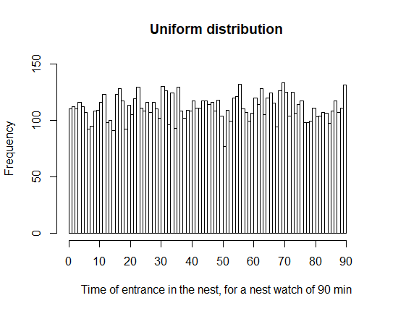
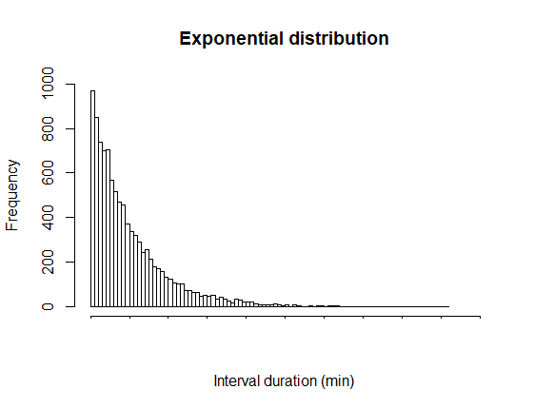
Poisson process assumption: exponentially distributed intervals
=
Shorter intervals are more likely – no refractory period

Slide 3
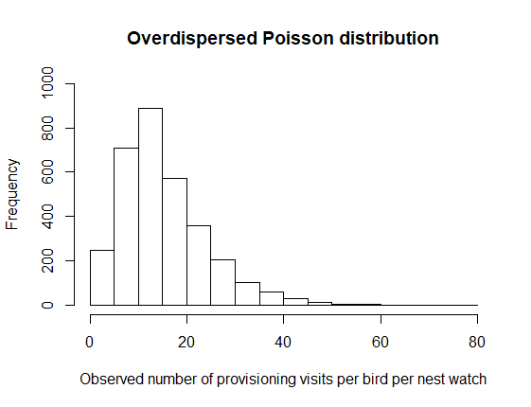
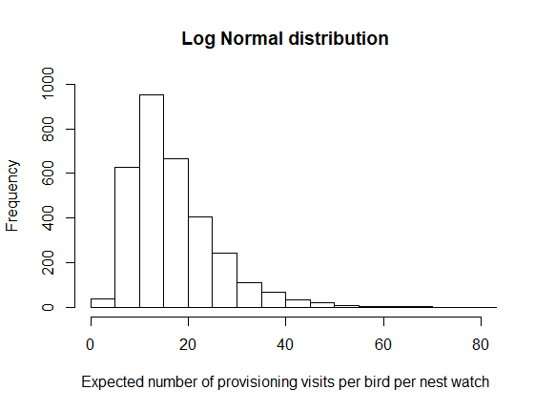
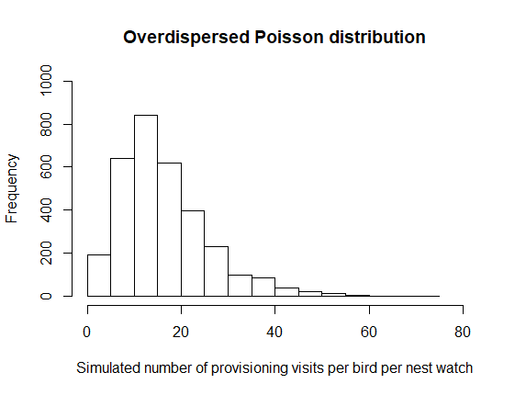
Simulation of nest watches with exponentially distributed intervals
1. Generate provisioning rates
a. Extract observed mean and SD
d. Simulate expected provisioning rates
e. Add Poisson distributed error to obtain simulated provisioning rate
b. Transform to expected mean and SD by removing Poisson distributed stochastic error
c. Transpose to the log scale using Jensen’s inequality

Slide 4
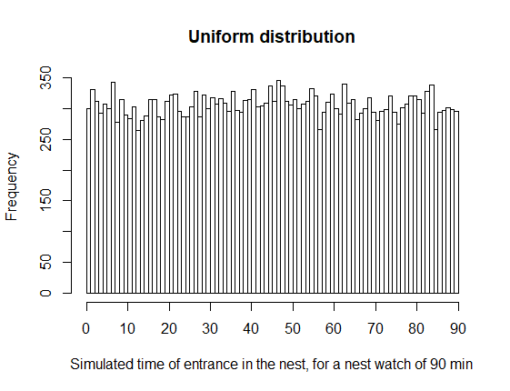
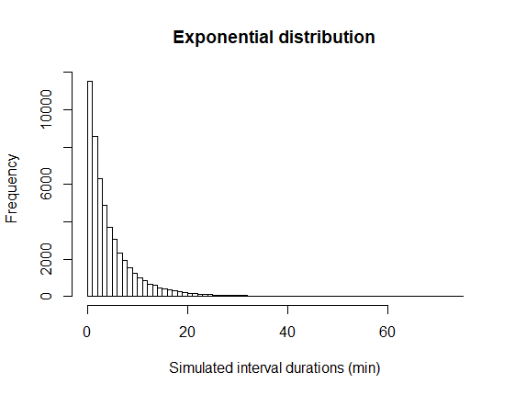
Simulation of nest watches with exponentially distributed intervals
2. Generate nest visits
3. Combine two birds’ nest visit times to form a simulate nest watch and calculate the number of alternated and synchronized visits
=
4. Repeat many times (here 1599, the number of observed nest watches)
a. For each bird and its number of provisioning visit simulated (nV), draw nV number of nest entrance times

